Slide 1
Introduction to Visual Perception
Creative Computing
Week 1
Brian Packer

Slide 2
Introduction
The significance of visual perception in computing
Overview of Creative Computing module

Slide 3
Outline
Preface: Revising Previous Knowledge
Topic 1: Fundamentals of Visual Perception
Topic 2: Visual Perception in HCI
Discussion 1: Applications in Game Development and MedTech
Topic 3: Evaluating Visual Signals
Research Synthesis: Cognitive Psychology vs Gestalt Principles

Slide 4
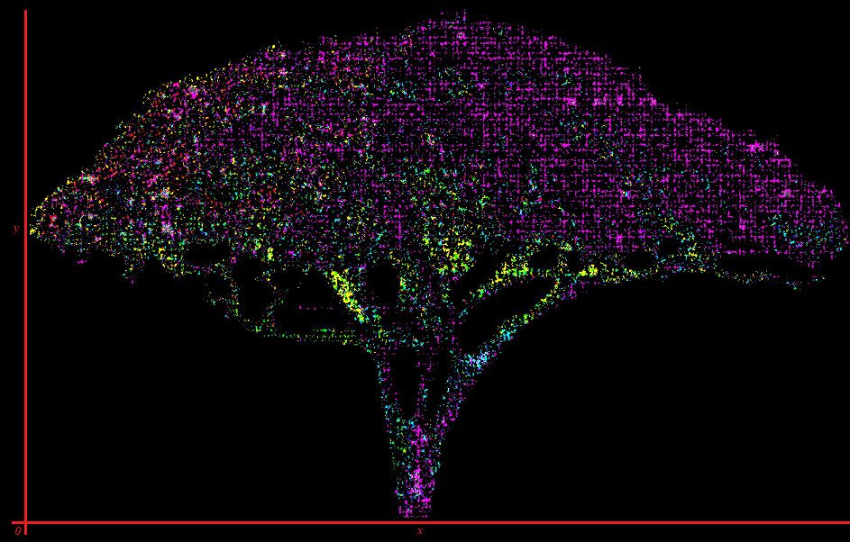
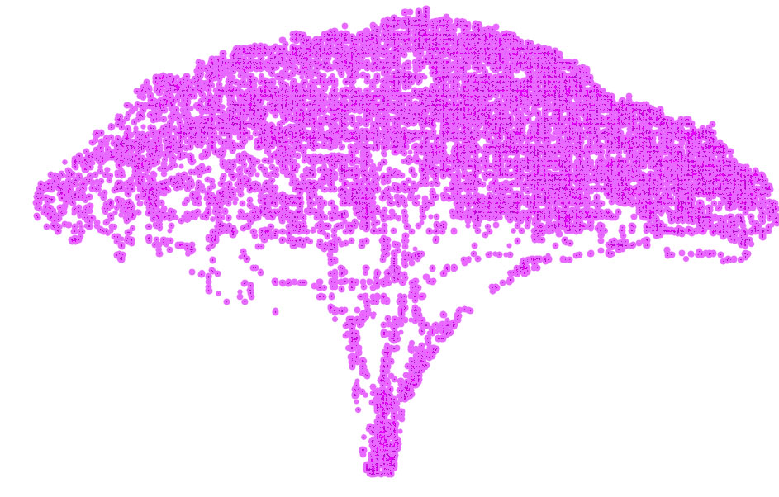
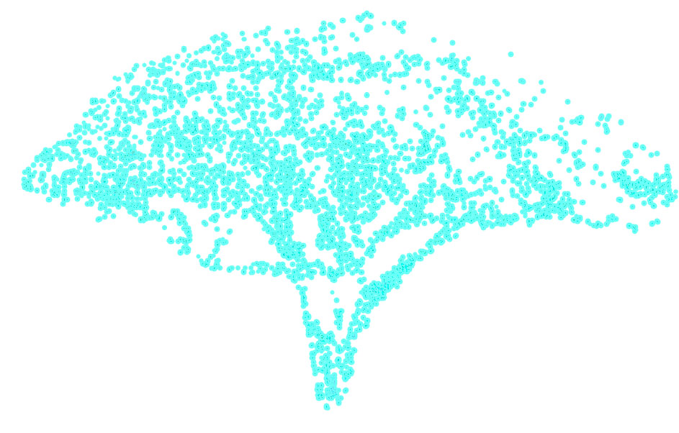
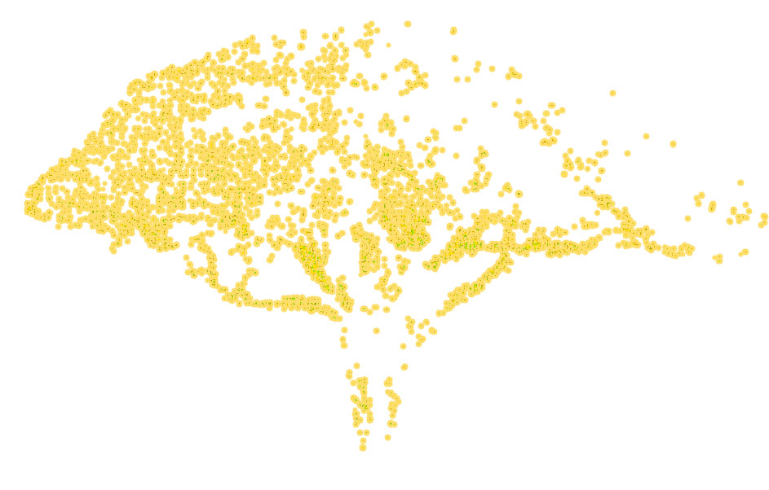
Revising: Everything Comes Back to Trees
Pixel Colour Data Analysis
Previously, we analysed pixel colour data from images of 2 different trees.
This exercise showcased how structured, digital data can be used to model an infinitely complex world.
This is fundamentally how computer vision emulates human perception.

Slide 5
Part 1: Understanding Visual Perception

Slide 6
Human-Computer Interaction (HCI)
Defining Human-Computer Interaction
Human-computer interaction (HCI) is a multidisciplinary field of study focusing on the design of computer technology, and particularly the interaction between humans (the users) and computers.
While initially concerned with computers, HCI has since expanded to cover almost all forms of information and digital technology design, including wearable, haptic, and mixed reality devices.
Defining Visual Perception
The process by which humans interpret and comprehend visual information.
Example: Identifying objects in our environment through shape, colour, and size.
Crucial for the development of interfaces that are intuitive and accessible.
Defining Computer Vision
The emulation of visual recognition and the associated cognitive processes by a computer.
Example: Facial recognition by evaluating rates of change in shadow to measure depth and contour of face shape and features.
Crucial for ruining society and enforcing a police state whereby the entrenched powers of the ruling class can absolve themselves of accountability by outsourcing their bigoted biases to technology which uses training data which disproportionately favours the persecution of people of colour and other people who have faced systemic persecution resulting in historical biases in the training data.

Slide 7
Perception in HCI
We can enhance graphical and user interface designs by applying visual perception principles.
For example: We may tailor UI components for better visibility.
This improves user satisfaction and promotes engagement by reducing friction and considering user comfort.
Sounds good, makes sense. Except we can’t agree on:
How visual perception works
How the human eye works
The standards by which to design
How cognition processes visuals
Who are audience should be
What our interfaces should do
What is important
Whether the earth is round or not

Slide 8
Basic Principles and Theories
Common Theories of Visual Perception
Influences on UX Design Practises
Gestalt Principles
7 factors which combine to influences perception of patterns and wholes, not just individual elements.
Similarity, continuity, closure, proximity, figure (grounding), symmetry, and order
Depth Perception
Involves how we perceive the spatial relationships between objects using contrast, colour, and light.
Theories: binocular cues, monocular cues.
Visual Hierarchy
Deals with organizing separate elements to convey distinction, importance, and guide attention.
Suggests cognition over alignment, grouping, and similarity occurs cognitively within sensory memory.
Gestalt Principles
Informs UI layout and component grouping to convey relatedness.
Helps make designs intuitive and satisfying to see and use.
Enforces holistic designs, not focusing on any aspect exclusive of another.
Rejects “reductive” notions of human vision as rational cognitive function.
Depth of Field
Used to create 3D effects for realism, priority cues, and projections.
Helps to designing visuals which convey spatial relationships.
Drives the computational science of rendering and colour profiling.
Visual Hierarchy
Content should be consistent & organised, limiting noise for clear visuals.
Supports logical flow and emphasizing key elements within interfaces.
Uses similarity to convey relatedness, and visual cues to convey distinction
Examples include cascading menus, white-spacing, and font sizes.

Slide 9
Optimising for Accessibility
Inclusive UI/UX design promotes accessibility for all users. Never exclude a viable user.
Optimizing visual information for diverse audiences presents many unique, case-by-case design challenges.
Try to automate that, GPT! (Or don’t. Please don’t.)
Colour Contrast
Adjusting colours to ensure readability for users with colour vision deficiencies.
Using tools like Colour Oracle to simulate various forms of colour blindness. [1]
Font and Text Size Customisation
Offering options for font styles and sizes to accommodate users with visual impairments.
Implementing responsive design to allow text scaling based on user preferences.
Accessible Navigation
Providing clear and intuitive navigation to assist users with cognitive disabilities.
Utilising ARIA landmarks and labels to improve screen reader accessibility. [2]
Image Descriptions and Alt Text
Including descriptive alt text for images to aid users who rely on screen readers. AI may soon automate this!
Using extensions like Axe to ensure alt text is present and descriptive for all images on a webpage. [3]

Slide 10
Part 2: Practical Applications, Discussion

Slide 11
Applications in GameDev and MedTech
How visual perception can enhance realism and immersion in games.
Example: Exaggerations in 2D and 3D animation to give a sense of momentum and physicality to objects, known as “stretch and squash”.
Example: Real-time lighting adjustments in games for enhanced depth perception which helps to create more engaging, immersive worlds.
How might visual perception principles enhance readability and data visualisation in MedTech applications, such as MRI imaging software?

Slide 12
Comparing Visual Strategies
Visual strategies vary significantly between entertainment and serious applications.
Example: The use of colour to invoke emotions in games versus for clarity in medical images.
Reflects the diverse applications of visual perception principles depending on context and objectives.

Slide 13
Part 3: Evaluating Visual Designs

Slide 14
Introduction to Visual Design Evaluations
Evaluation methods for reviewing visual (graphical) designs and interfaces differ across various contexts. This requires a tailored approach for each situation, but the most common include:
Heuristic Evaluation
Involves experts assessing designs based on usability principles.
User Testing
Observing real users interacting with the design to gather feedback.
A/B Testing
Compares two versions of a design to determine which performs better.
Heuristic Evaluation
Identifies usability issues early in the design process.
User Testing
Provides insights into user preferences and behaviours
A/B Testing
Helps in making data-driven decisions to improve design effectiveness.
Effective evaluation is contextual, adapting to the specific needs and objectives of the project and the users.

Slide 15
Common Mistakes in Evaluations
Biased Interpretation
Evaluators may interpret results based on personal preferences rather than objective criteria.
Insufficient User Representation
Testing with a limited user sample may not capture diverse user perspectives and needs.
Overlooking Context
Failing to consider the broader context in which the design will be used can lead to inaccurate evaluations.

Slide 16
Summary
Reviewed the fundamental principles of visual perception and its pivotal role in creative computing.
Further Learning
Recommended readings on advanced visual perception theories such as salience and the working memory model.
Look up some emerging trends in HCI and visual design from 2023 and how they are changing to lead competitive best practises.
You should experiment with evaluating your own interfaces in both personal and academic projects, seek comfort and productivity changes.

